Slide 1


Spring Data JPA: Effortless Data Persistence
Spring Data JPA simplifies database interactions. It reduces boilerplate code. Focus on business logic. Enjoy streamlined data access.
by vaibhavi panchal

Slide 2
Introduction to Spring Data JPA
What is it?
Why use it?
Key Features
Spring Data JPA is a tool. It simplifies data access using JPA. JPA is Java Persistence API.
It minimizes boilerplate code. Development is more rapid. Focus on core business logic.
Repositories, entities, and annotations are supported. Custom queries can be derived. Reduce lines of code.

Slide 3

Core Concepts
1
Repositories
2
Entities
3
Annotations
Interfaces for database access.
Represent database tables.
Configure entity mappings.

Slide 4
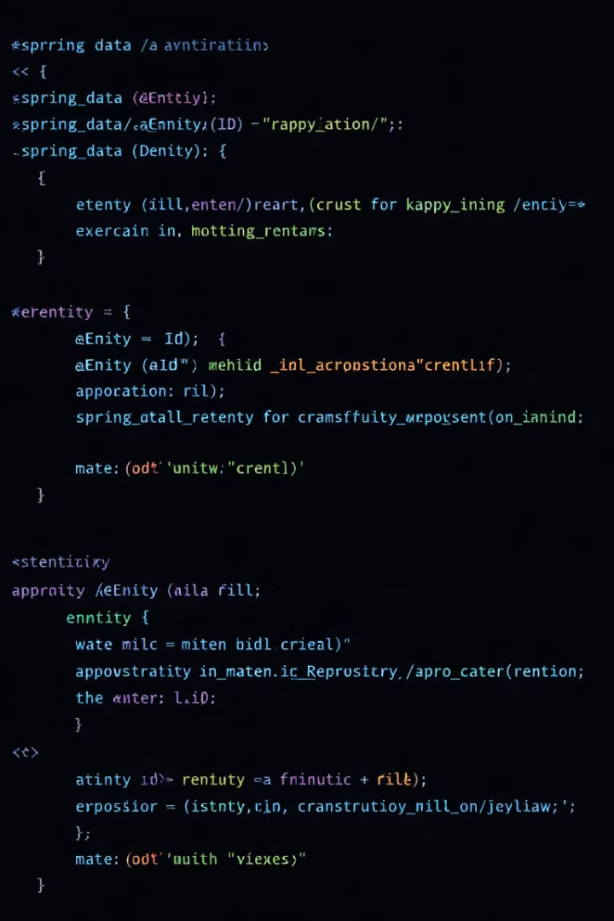



Simple CRUD Application
Define Entity
Create a Java class. Annotate it with @Entity.
Create Repository
Extend JpaRepository interface.
Implement CRUD
Use save(), findById(), findAll(), delete().

Slide 5





Database Operations
Create
Read
Update
Delete
Saving new entities using save().
Fetching entities using findById().
Modifying existing entities.
Removing entities with delete().

Slide 6
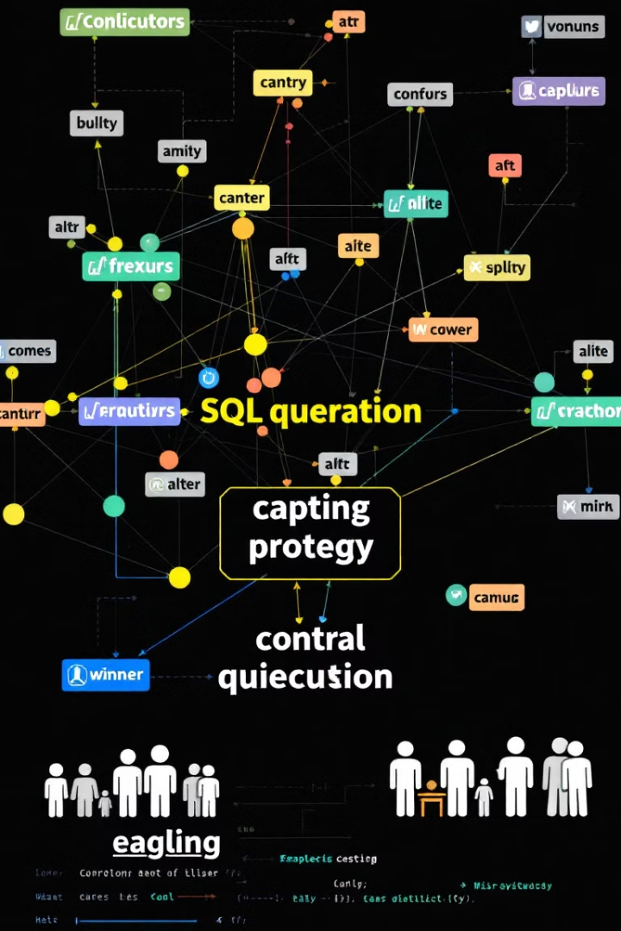
Advanced Querying
Custom Methods
Derived Queries
Define methods in repository. JPA generates queries.
Method names define query logic. Follow naming conventions.
Example
findByLastName(String lastName) translates to the SQL WHERE clause last_name = ?.

Slide 7




Advantages of Spring Data JPA
Less Boilerplate
1
Faster Development
2
4
Improved Performance
3
Easy to Use

Slide 8

Conclusion
Spring Data JPA simplifies database interactions. It reduces boilerplate code. Focus on business logic.
Key takeaways: streamlined data access, efficient development, and easy maintenance.
Next steps: explore advanced features, integrate with other Spring modules.

